Slide 1
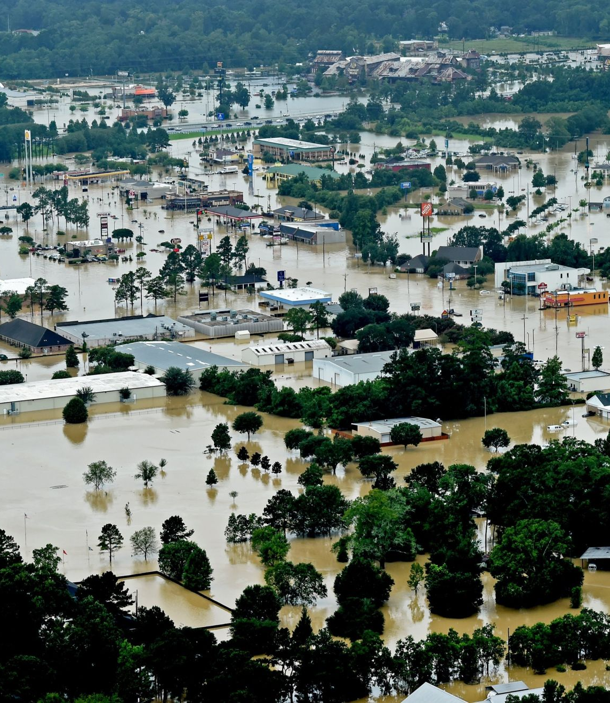




Flood Impact Detection using AI and Remote Sensing Data – Progress & Roadmap
Nethma Pathirana | Research Intern
Under the supervision of Associate Prof. Raj Prasanna & Malintha Ranasinghe

Slide 2
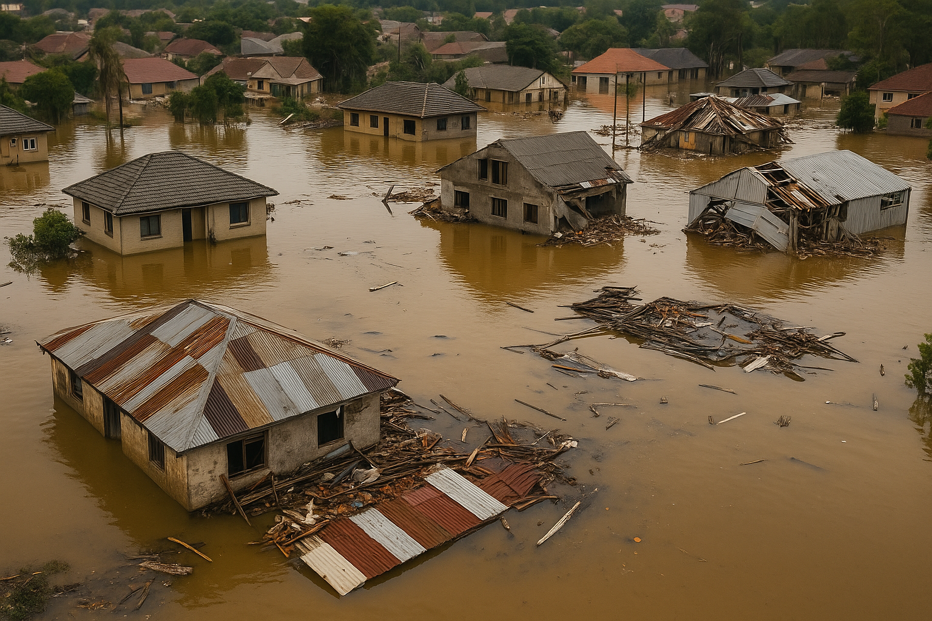
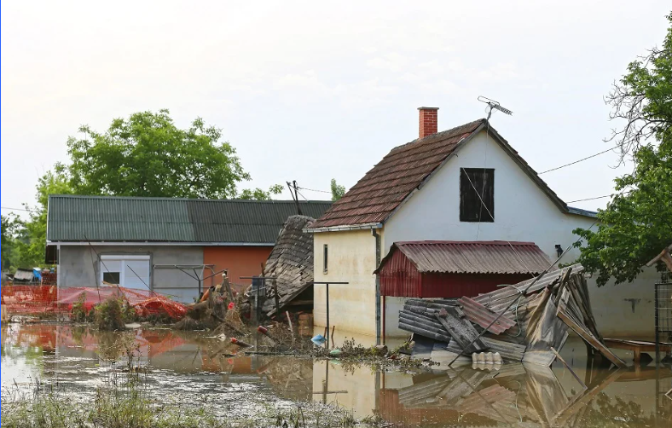
Problem & Goals
NZ floods (e.g., Cyclone Gabrielle) need faster damage detection
Manual image review is slow and not scalable
No existing flood impact dataset for NZ
Goal: Use AI to detect flood damage from images and news
Objectives:
Build a flood impact dataset
Train AI models on drone images
Match image results with news-based impacts

Slide 3
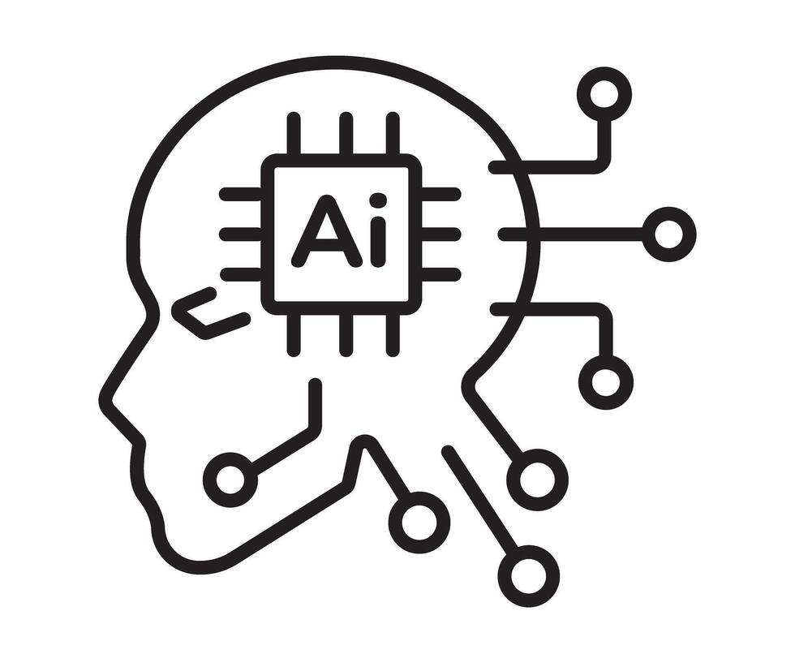
Our Approach
Damaged
Classification
Fine tune existing AI model
Non-Damaged
Drone Images (Using Remote Sensing)

Slide 4
Challenges
Satellite resolution & revisit time:
Satellite images often lack detail and may be days apart, making it harder to detect small or recent damage.
Manual annotation effort:
Labelling flooded vs non-flooded areas by hand is time-consuming, especially for large datasets.
Defining “damage” for AI models:
Damage can look different depending on the scene, making it hard to create consistent labels for training.

Slide 5
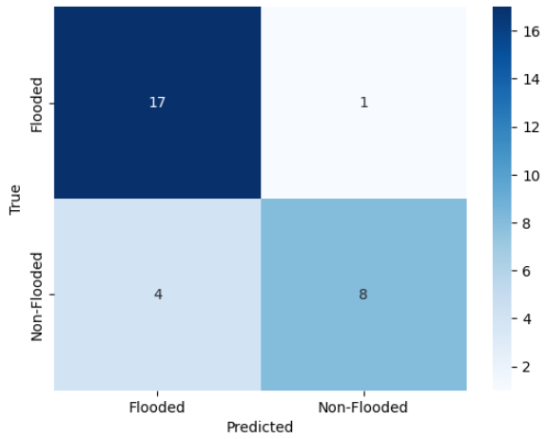
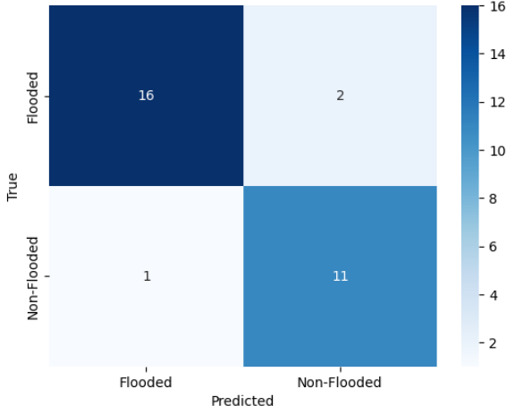
ResNet50 Model Results
10 Epochs – Best Result
  Accuracy: 90%
  Balanced precision and recall
  Only 3 misclassified images
20 Epochs – Weaker Result
  Accuracy dropped to 83%
  Recall improved for Flooded class
  Non-Flooded detection got worse
Conclusion: 10-epoch model performed better overall

Slide 6
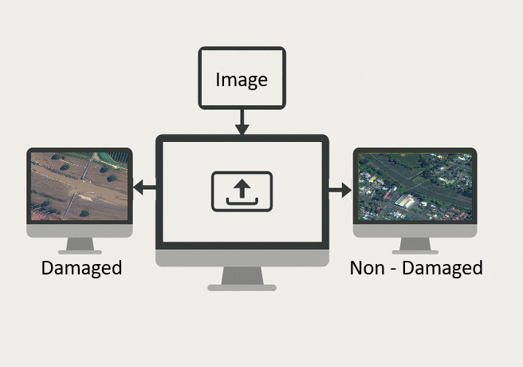
Next Steps – Image & Text Analysis
Image Analysis:
Train YOLOv8 & U-Net for damaged vs. non-damaged areas
Scale classification to ~1000 drone image tiles
NLP Component:
Extend Vajiranath’s work (LLMs for news impact extraction)
Cross-validate image and text results
Publish an article

Slide 7
Thank You!

