Slide 1
Creating an Earthquake Catalog Using Raspberry Shake Data in New Zealand
Presenter:Tasfia Zaman Samiha
Mentor:Danuka Ravishan

Slide 2
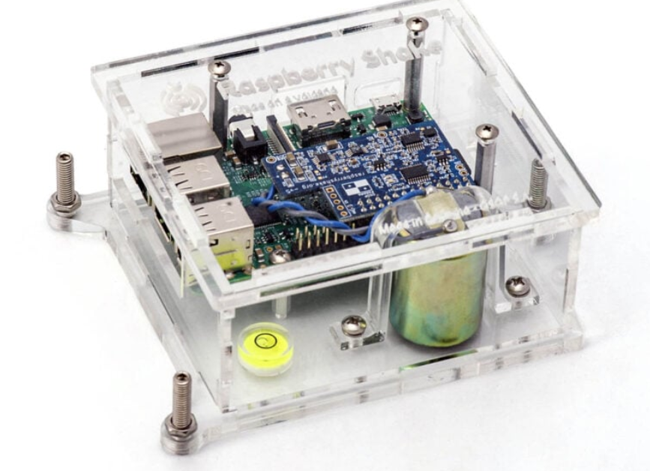
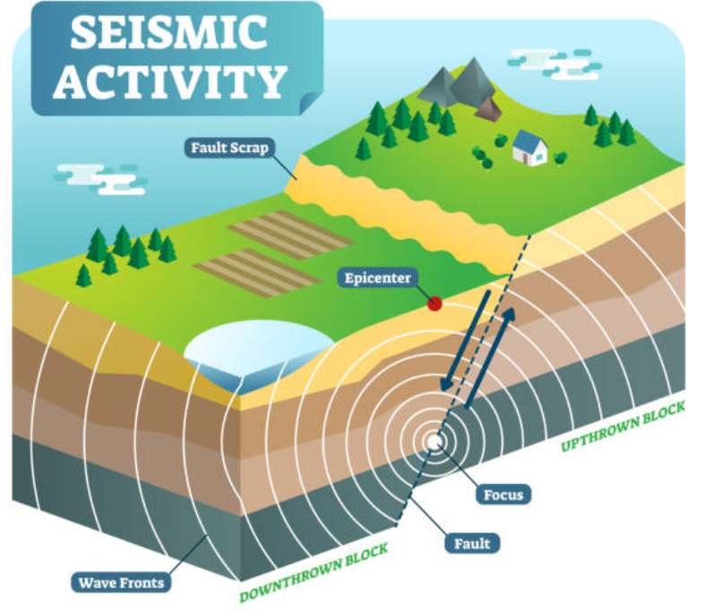
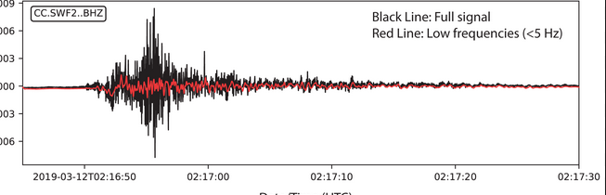
Raspberry Shake
Sensors
Earthquake Waveform

Slide 3
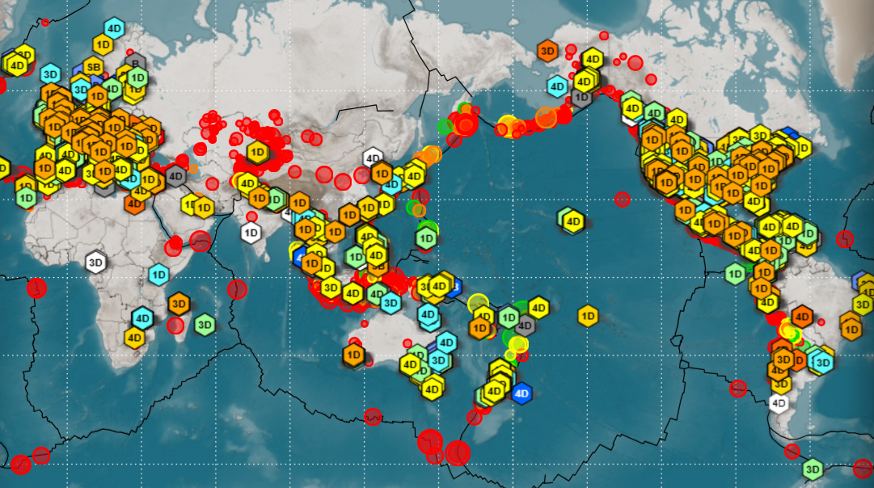
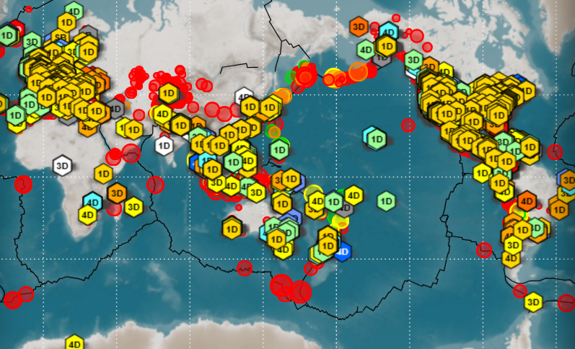
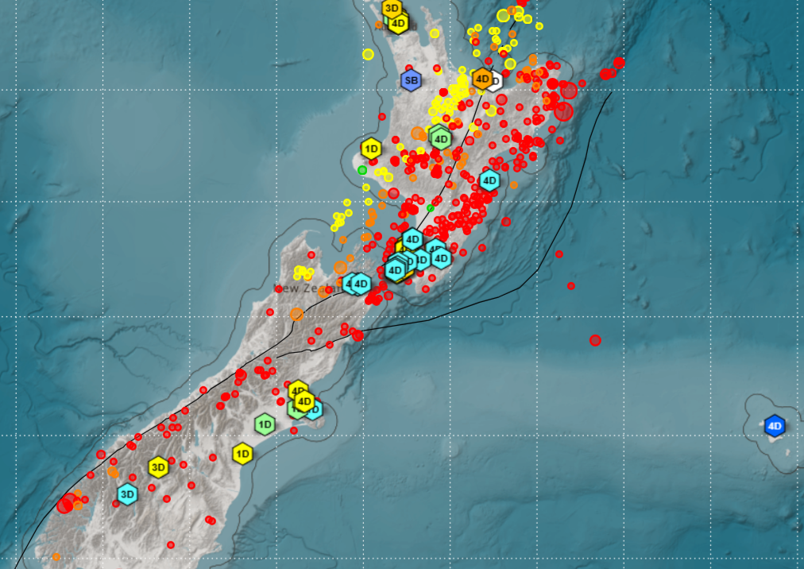
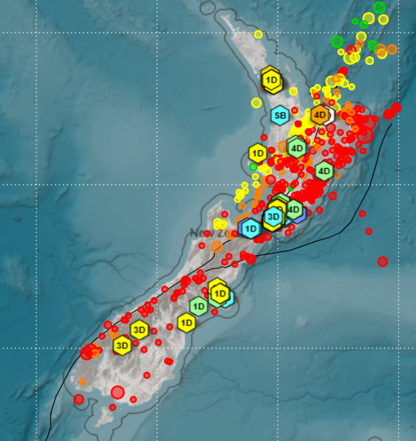
Raspberry Shake Stations

Slide 4
Station Filtering
Filtering out the stations that contains 4 channels
Channel1
ENZ
Station
R3AFA
Channel4
Channel2
EHZ
ENN
Channel3
ENE

Slide 5
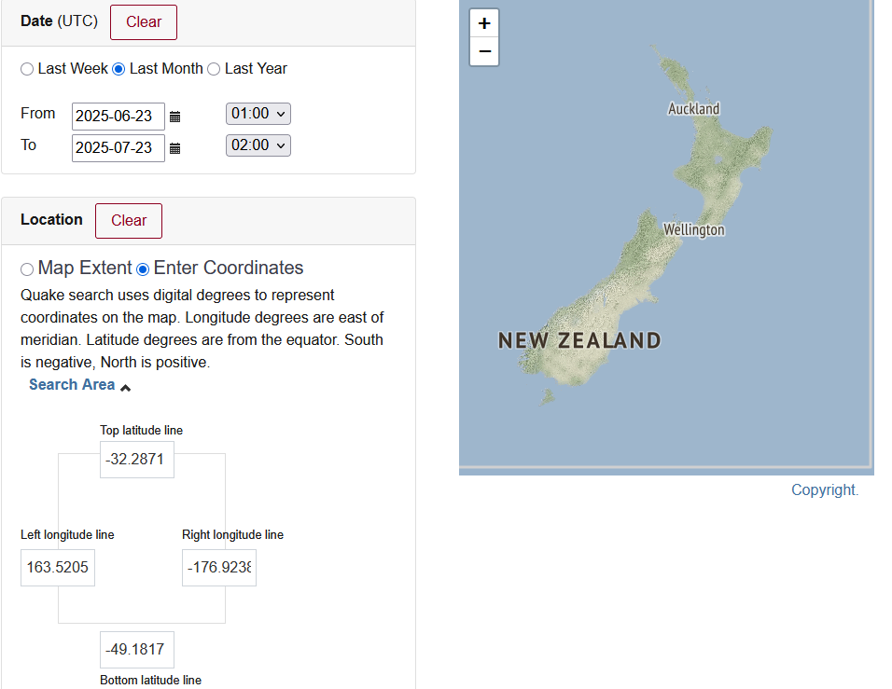
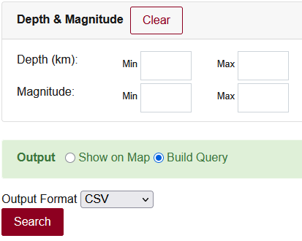
Geonet Earthquake Data Collection
GeoNet Data Query Parameters
-Date Range(2019-2024)
-Latitude(-32.2871,-49.1817)/Longitude(163.5205,-176.9238)
-Minimum(2.7) & Maximum Magnitude (9)
-They provides a csv for that query

Slide 6
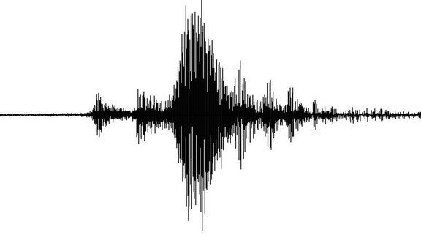
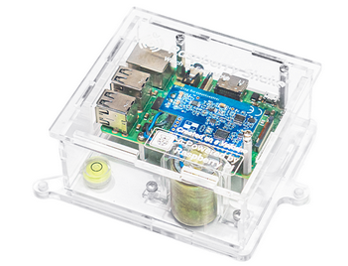
Earthquake Data Integration
Information about Raspberry Shake Stations
Earthquake data from Geonet (2019-2025)
Get the earthquake waveforms(2019-2025) from Raspberry Shake Stations

Slide 7
Overview of the dataset
●10,223 earthquake records
●Covers data from 2019 to 2024
●Includes magnitudes from 2.7 to the highest recorded
●Each record spans a 3-minute time window
●Each file includes 3 traces (E, N, Z)
●Waveforms from stations within:
○100 km radius for magnitudes 2.7–5.5
○150 km radius for magnitudes above 5.5

