Slide 1
LoRa Network For Emergency Communication and its Management System
Migada Perera and Toby Connor-Kebbell
Notes:
Good afternoon everyone
I am migada a 4th year software engineering student at Victoria University of Wellington
I started my internship In november of 2024 and have been working part time since february 2025
Today Toby and I will be presenting the current state of our research into a LoRa network for emergency communication and its management system
The current purpose of the research is to
Provide a way for people to stay in touch with family and friends During a natural disaster While also allowing use to manage the network remotely
CrisisLabs end goal for this project is to make a network to let us maintain communication with other crisislab projects during disasers.

Slide 2
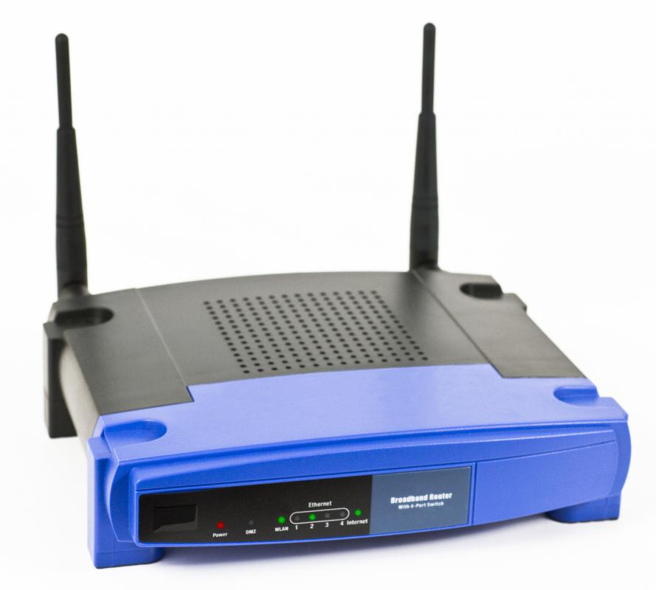
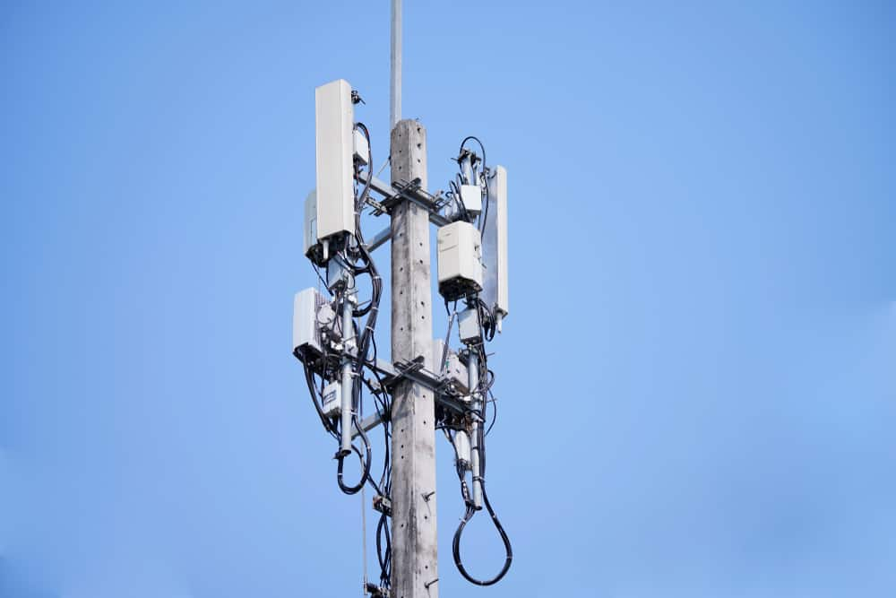
Why not use existing communication technologies
Lots of grid powered infrastructure
High power consumption devices
Expensive devices
Notes:
You may be thinking why can’t we use the existing broadband or mobile network for this
The main limitation they have is their power hungry infrastructure.
In the event that a natural disaster shuts down the national grid completely or partially, the infrastructure these networks rely on will not last long on back up power sources.

Slide 3
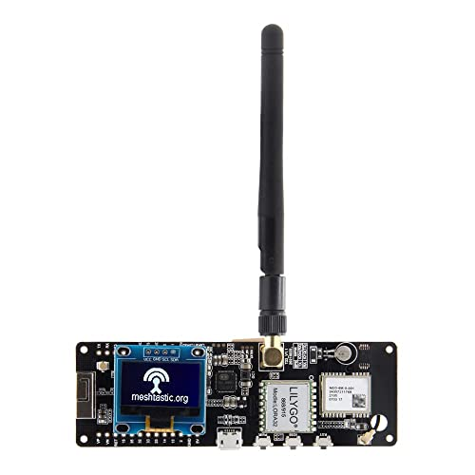
What we are using instead
11 kbps
Long Range
No public infrastructure needed
Can run on battery power
Notes:
So instead, we have decided to create a network using LoRa devices
More specifically the Lilygo Tbeam as it can
Send messages over many kilometers Without relying on public infrastructure While running for extended periods of time on a backup battery.

Slide 4
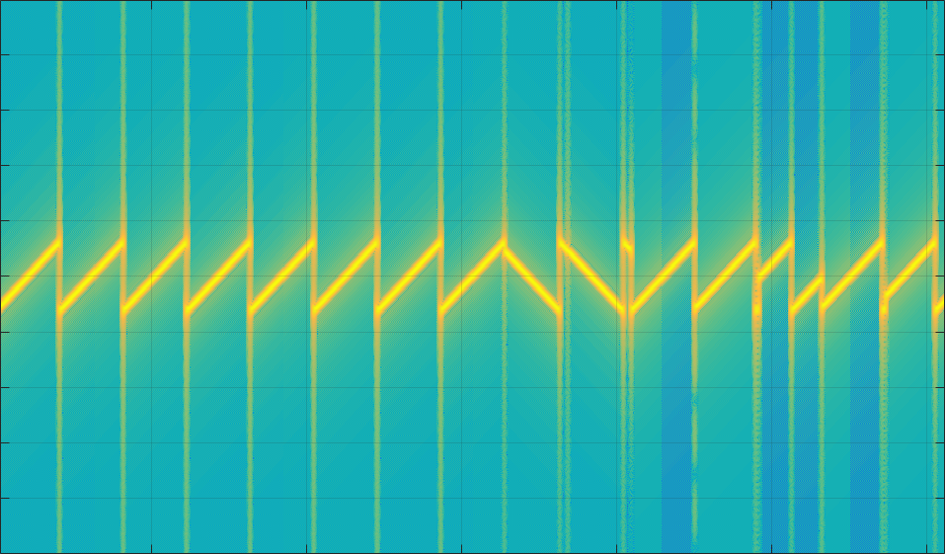
What is LoRa?
Each UP or Down movement is a symbol.
The shape of the signal makes it resistant to interference
Requires less power to send
Allows longer battery life
Notes:
For those who do not know what LoRa is
It is another way to send data over radio waves, similar to the FM used by radio stations.
However where fm sends data encoded as the change in frequency. Lora sends data in these rising and falling frequency patterns as shown above. Each different one is a different symbols. While this limits how fast we can send data, the unique shape of the signal means that a receiver can understand it even with a lot of interference mixed in.
So since the signal is more resistant to interference the devices can transmit with lower power and still be heard, which is one of the reasons their batteries last so long.

Slide 5
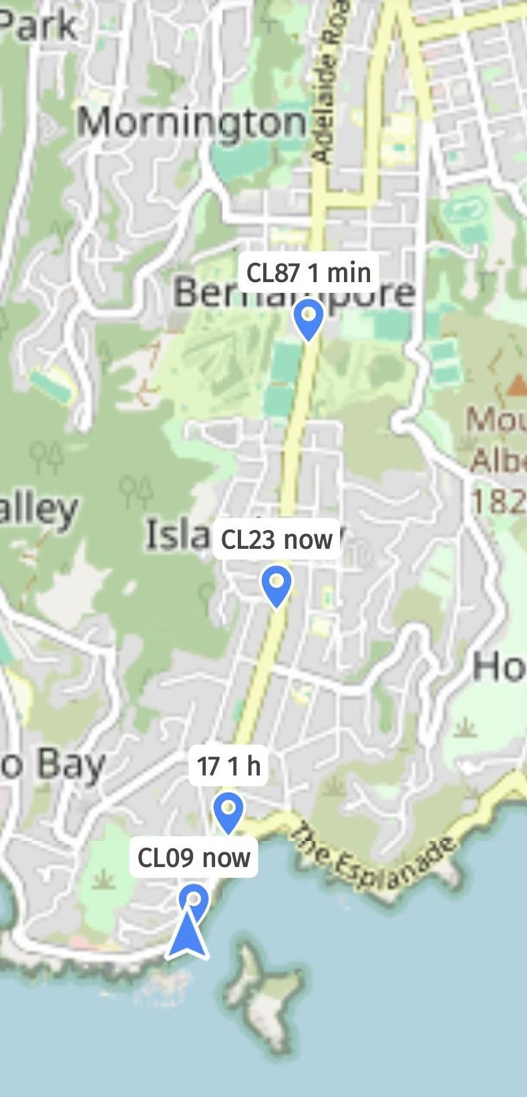
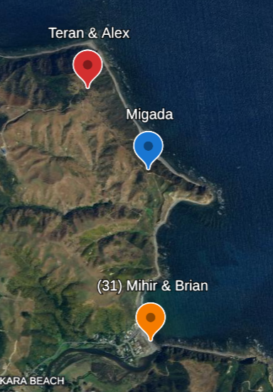
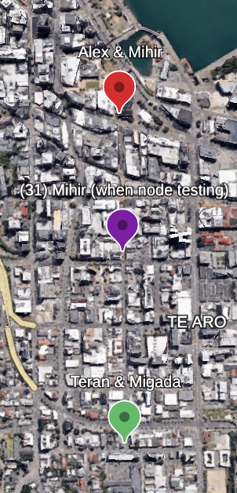
Where we tested
Notes:
Before we started deploying devices and developing the management system, we did some testing to figure out the limitations of LoRa.
We tested in three locations which were Makara Beach, Cuba st, and Island bay. For each location we would measure the time taken for messages to make a round trip at all different radio settings. We would do this with a direct connection and then with one hop between the two nodes.
From the results of the tests we found that the devices could send messages up to 2 to 3 kilometers in most areas. However in places with lots of buildings like cuba st, the range would reduce to just under 1km due to loss of line of sight after you turned a corner. We also found that if the node was higher than surrounding buildings these range issues were largely mitigated.
From the speed tests, the average speed was approximately 3s when connected directly and approximately 6 seconds when one hop away. This meant the network work would be good for public safety announcements and keeping in contact with family but would be too slow for time critical applications such as earthquake early warning.
So with this information in mind we went on to deploy our network.

Slide 6
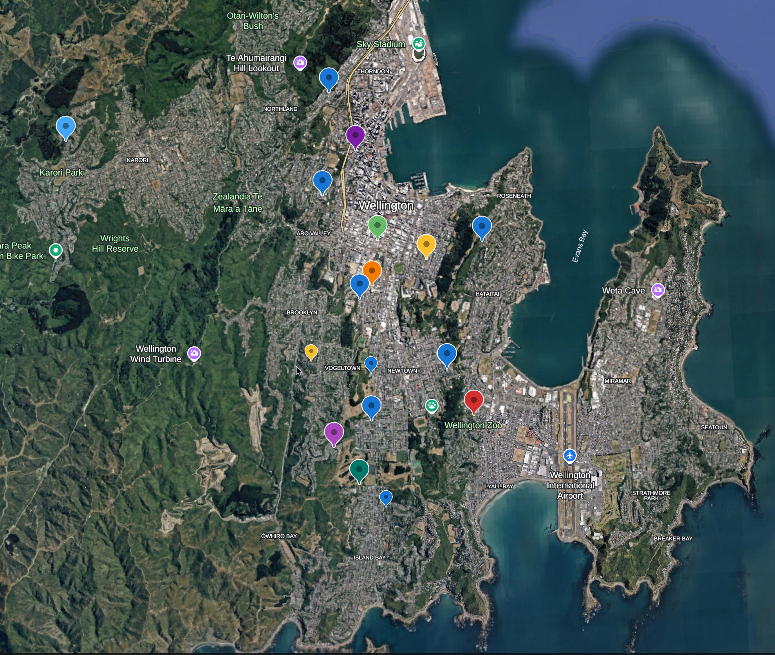
The Deployment
Nodes are hosted by volunteers at CRISiSLab.
Increased coverage by hosting nodes at Victoria University and Massey University
Areas with high rise buildings severely reduce range.
The public network is able to fill in the areas without connection.
Notes:
Started after the main internship.
Hosted by crisislab volunteers vic and massey to improve coverage
Once deployment finished we sent messages on group chat,
From screenshots i deduced
Tinakori and kilbernie were not directly connected due to physical obstructions,
Nodes in islandbay and central wellington had strong connection to each other
After switching to the public network, most holes in the network were filled, except for areas with many highrise buildings.

Slide 7
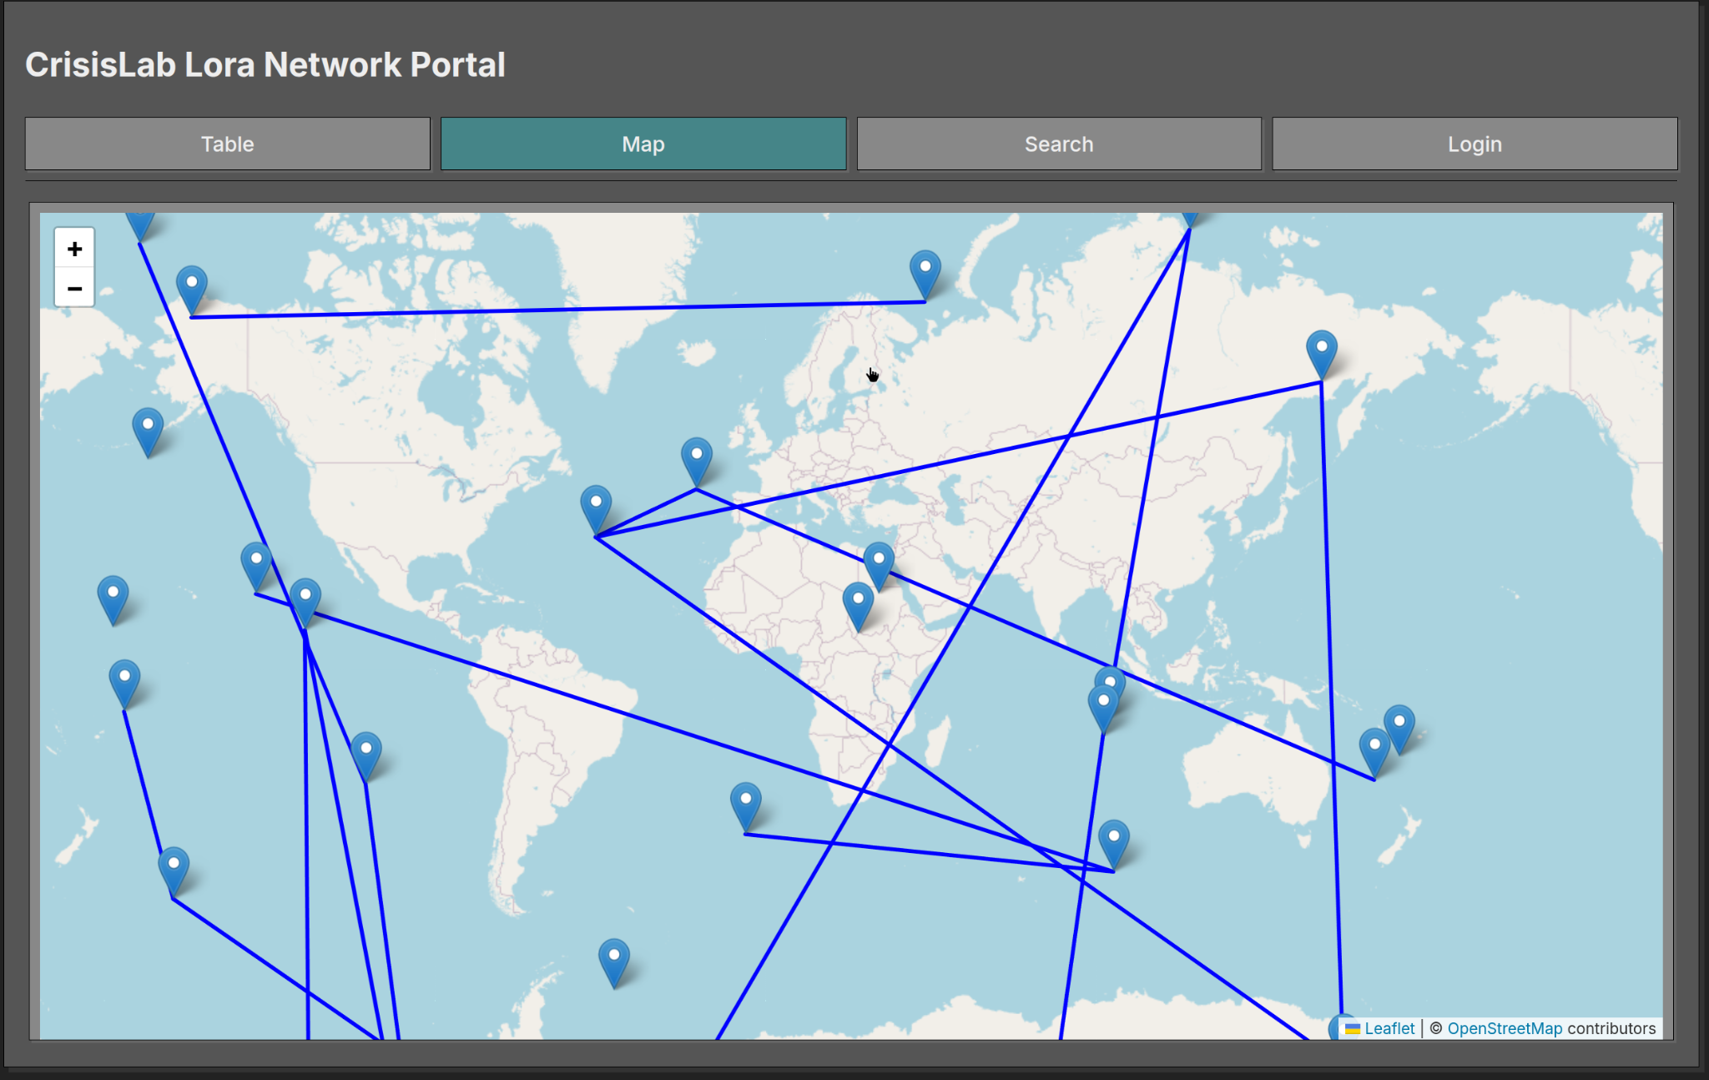
Management System: Front-end
Notes:
From around january 2025 toby and I have been working on a system to remotely monitor and manage a network of LoRa nodes.
I had experience in creating webapps, I handled thne front end and authentication server.
Written in rust with rocket framework.
The webapp was written in react and uses the leaflet map library.
Each pin is a node. Random since I used randomised data during development
When pin is clicked important info is displayed. There is a link to detailed info
Each blue line would be a route between nodes. Currently when clicked only nodes connected is shown however in future more information will be available

Slide 8
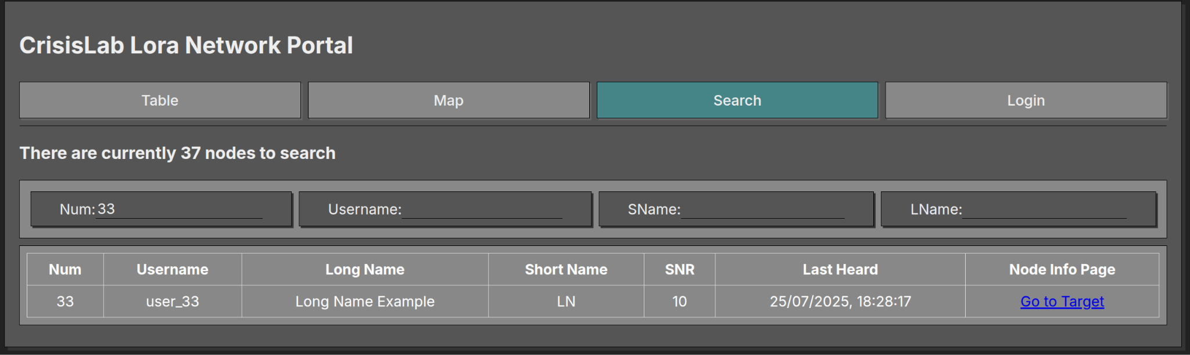
Node Search Page
Notes:
This page allows a user to search for a node based on parameters such as id number, user name or devices names. Each entry will have a link to the device’s node information page.

Slide 9
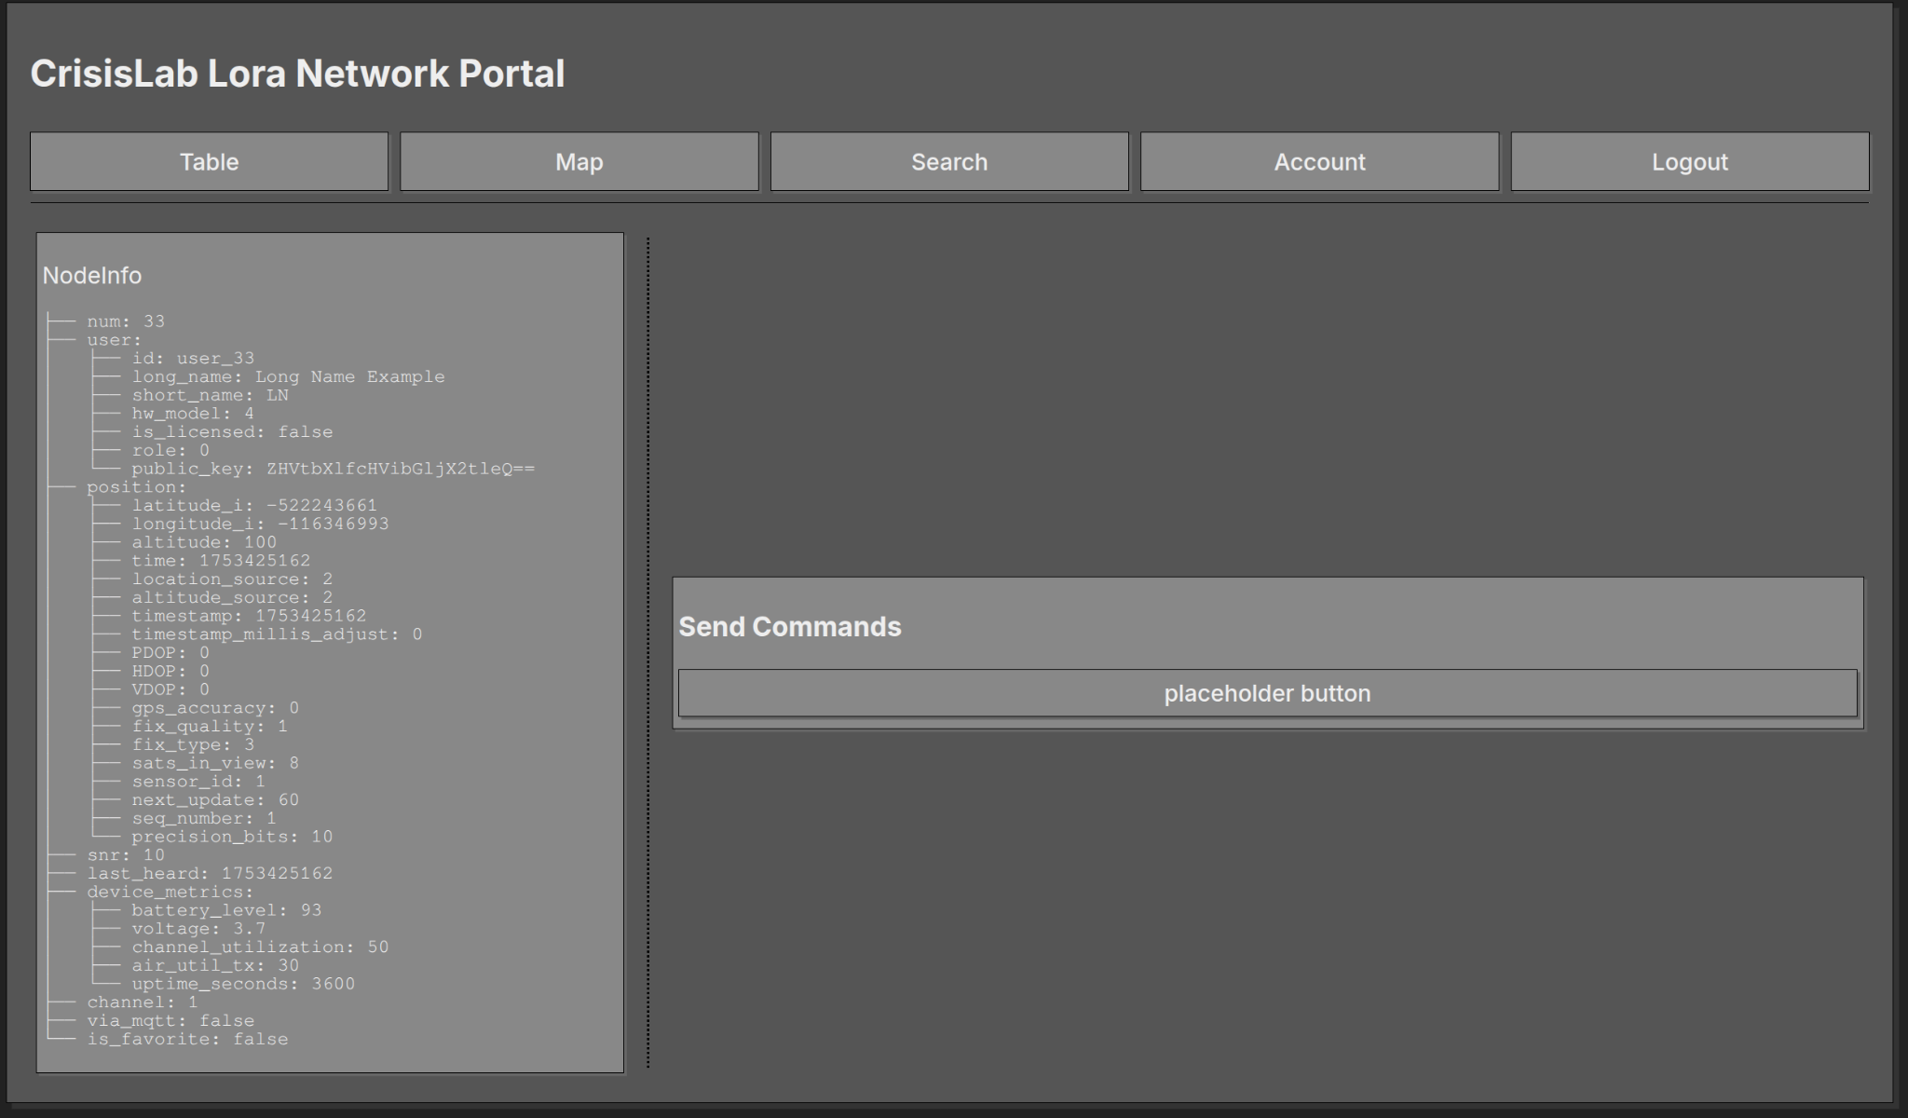
Node Information Page
Notes:
When a user clicks on a link from either the map or the search page they will be sent here.
When you are logged as a normal user, you will only see the node info pane, however if you are logged as an admin, they you will be given the send commands pane next to it. This is currently still in development. In the future you will be able to send commands directly to the device this will allow us to change the configuration of a device manually.
When a user clicks on a link from the map or search page they are send here.
When logged in as normal user the only the left pane is visible showing info about the node
When logged in as admin user the right pane is shown.
Currently under development, will be able to send commands to remotely configure devices.

Slide 10
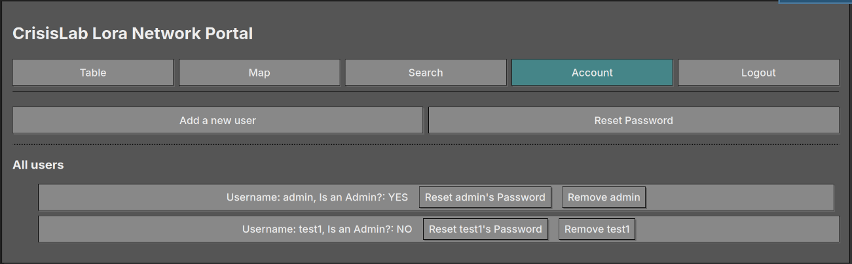
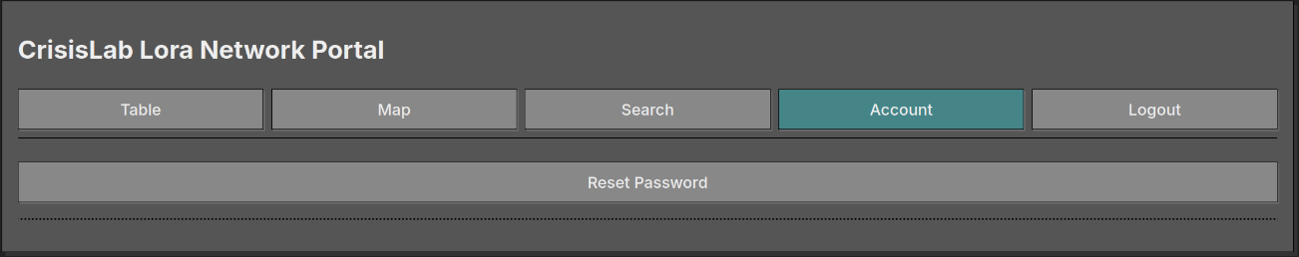
Accounts management page
Notes:
The account page,
When logged in as normal user you can only change your password
But as an admin you can add and remove users and change their passwords as well
That is all the functionality of the webapp
Will now pass on to Toby to explain the design and functionality of the servers and firmware.

Slide 11
How does all of this work?
Notes:
Kia ora, I'm Toby
I'm from here in Wellington
And I'm in my final year at high school at Wellington High School
I joined CRISiSLab through a competition last year which they run annually, which led to a small internship at the beginning of this year, which has led this current internship working as a research assistant on this project.

Slide 12
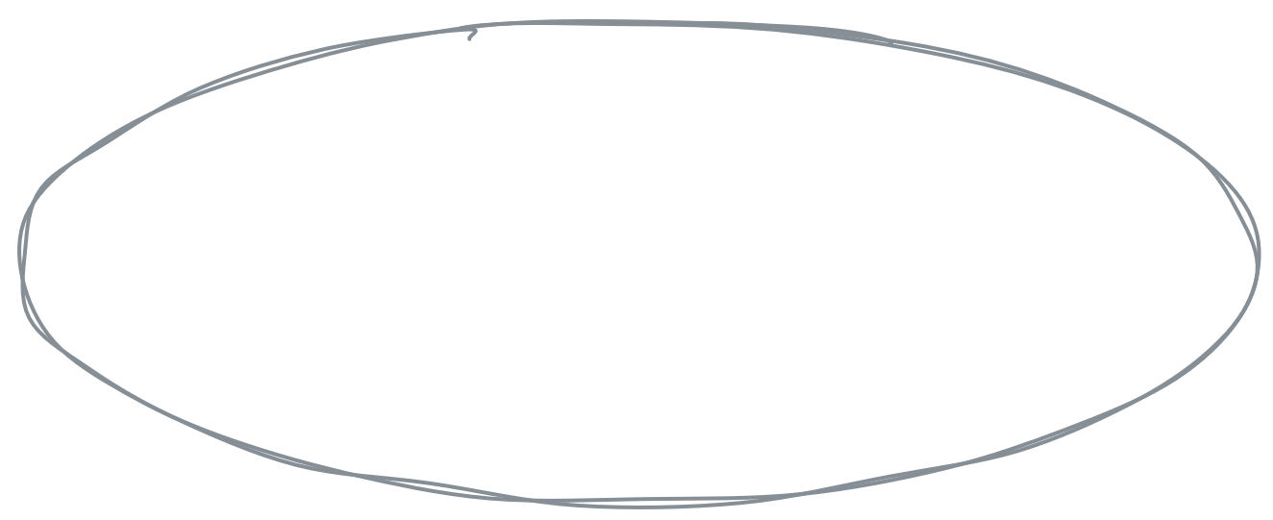
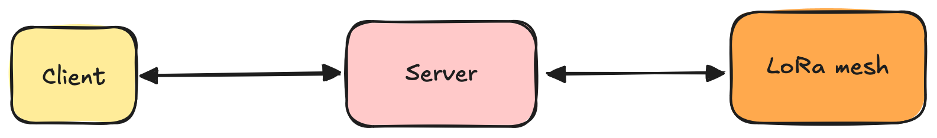
High-level diagram
Notes:
To briefly explain what my role is, in this simple diagram:
The yellow box on the left – the client – is what a user of this system would interact with, and that's Migada's job
And I'm responsible for these two parts:
the software on the radios (which we call NODES) in our network (which we call a MESH)
and the server, which is an intermediary between the two

Slide 13

What exists already?
Open-source
Software for the radios
Apps for web and mobile
Decentralised
Notes:
Writing software from scratch for a LoRa radio is a huge job, so luckily there's a project that already exists, called Meshtastic
It's an open source project including software for the radios, and apps which you can use on a phone or computer when you're connected to a node via bluetooth, WiFi, or a cable
Meshtastic is also a decentralised system which is great because in the case of a natural disaster you don't have any single point of failure.

Slide 14
What can Meshtastic's apps do?
Display other radios on a map
See key information
Send encrypted messages
Collect telemetry
Configure your node
Perform basic actions
Trace routes
Notes:
Display other radios on a map
See key information (like names and battery levels)
Send encrypted messages (directly to another node or on a shared channel)
Collect telemetry, basically live metrics (from your node, or request it from others)
Configure your node (or remotely configure others which have been configured to permit it)
Trace routes (between your node and another)

Slide 15

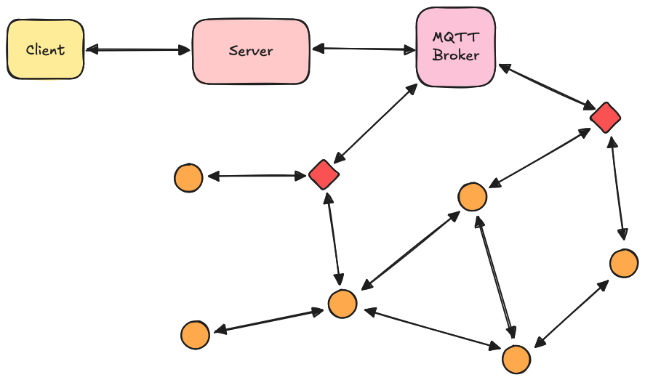
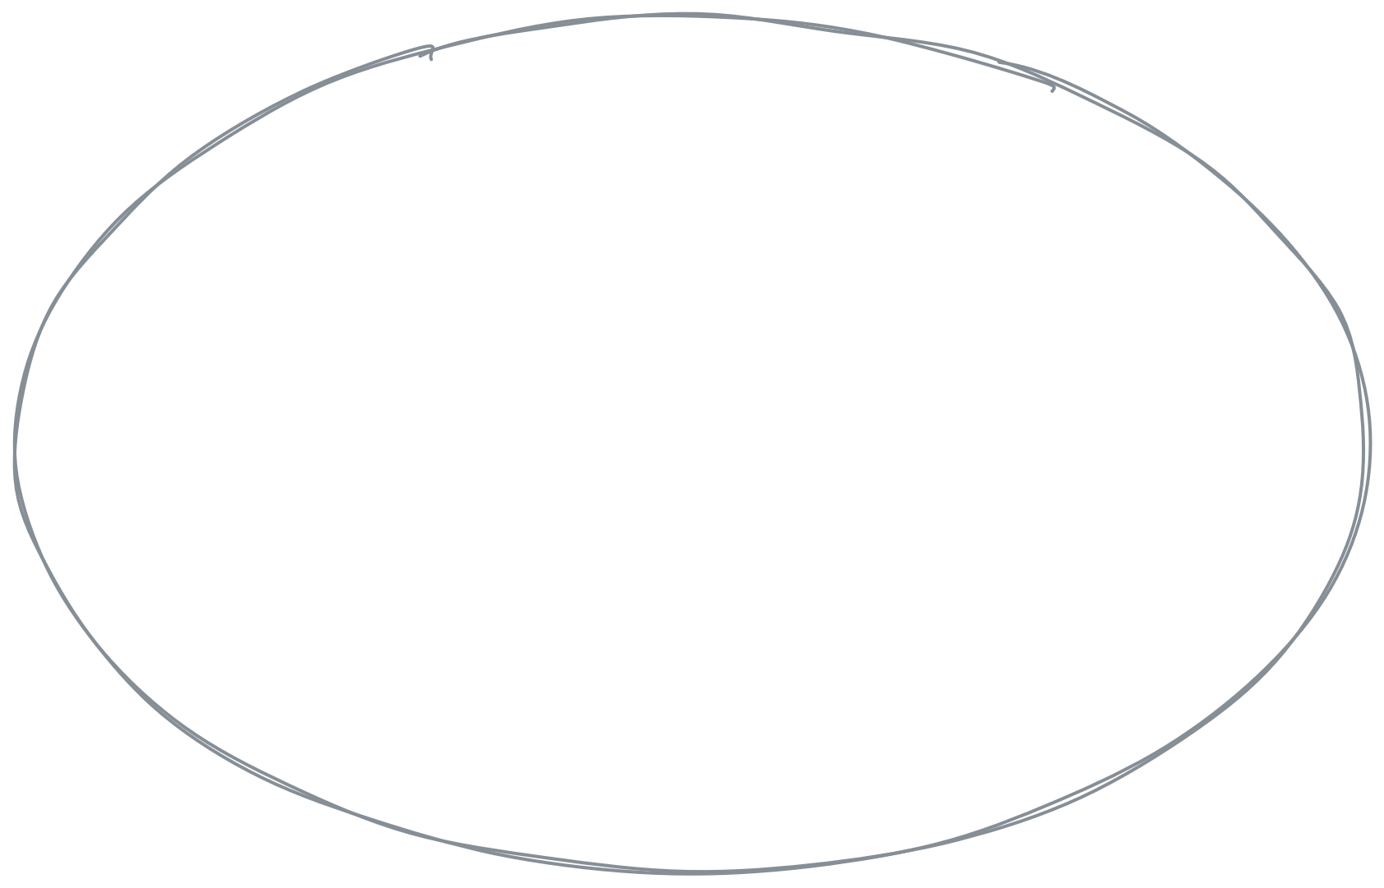

High-level diagram
Notes:
The small orange and red circles and diamonds are LoRa radios in the network
We said earlier that LoRa doesn't use the internet, but because they can use bluetooth or WiFi to connect to your phone we can use that
Red ones have internet access (by being at someone's house, for example)
Orange ones don't
The ones with internet (which we call gateways) can talk to our server via an MQTT broker. I won't go in to MQTT so if you've never heard of it, you can pretty much pretend it isn't there
Now, if we're that circled node at the bottom…

Slide 16
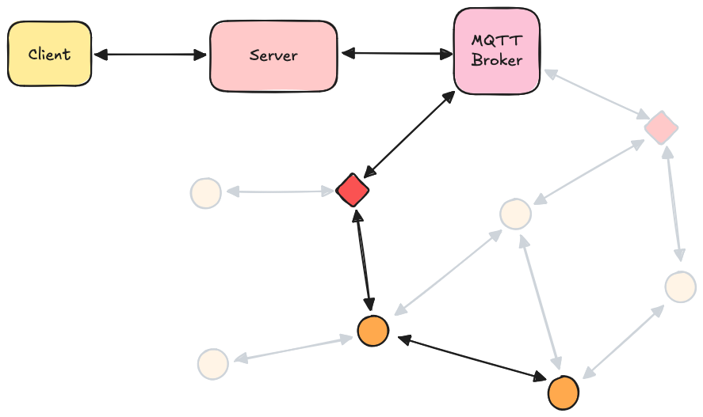
High-level diagram
Notes:
We could communicate with a client with using this route…

Slide 17
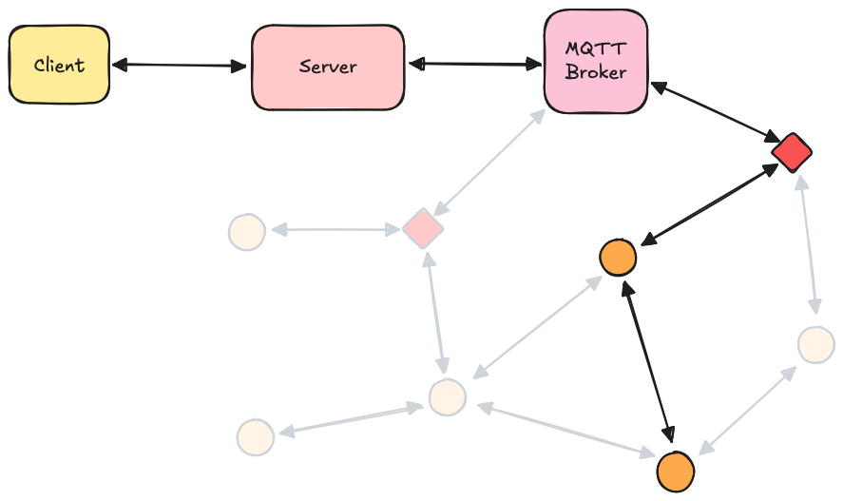
High-level diagram
Notes:
Or this route, or any other combination

Slide 18
The first problem
Meshtastic doesn't use pathfinding
Uses a "flooding" method instead
Works well for a decentralised network
High number of retransmissions
Not as efficient as predetermined paths
Notes:
This brings us to the first problem, which is that meshtastic can't really do this
Instead is uses a "flooding" method, which I'll show you with an example

Slide 19
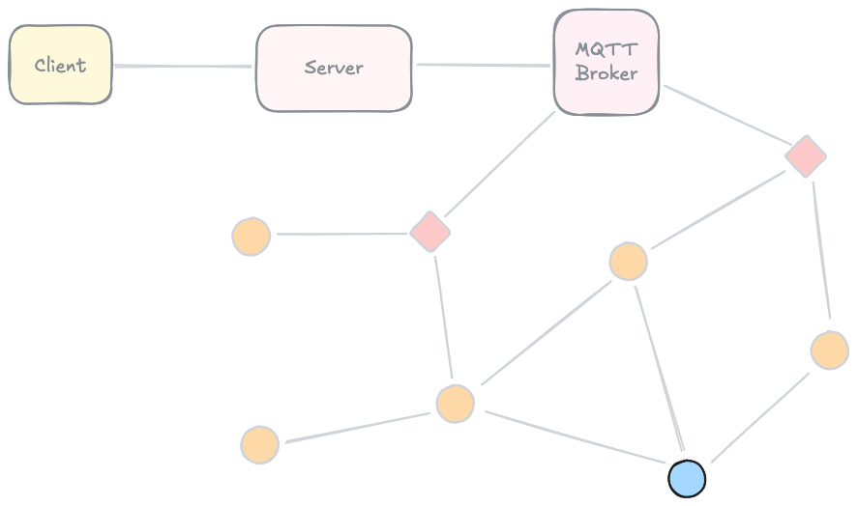
An example of the "flooding" method
Notes:
If we're the blue node at the bottom and we want to get a message to a gateway radio, and therefore to a client, this is what Meshtastic would do…

Slide 20
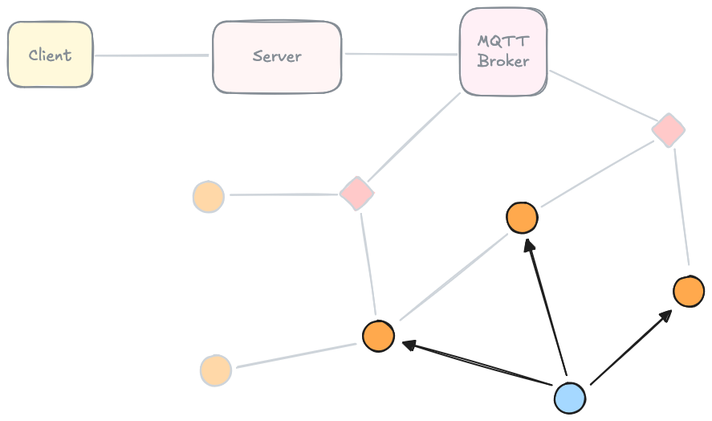
An example of the "flooding" method
Notes:
It would broadcast the message, and say, those three orange nodes get the message.

Slide 21
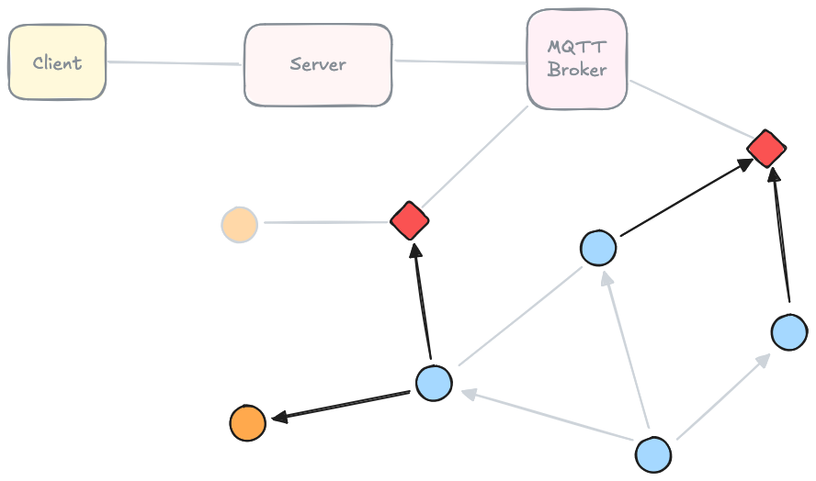
An example of the "flooding" method
Notes:
Next, they would broadcast it, and finally it would reach a gateway…

Slide 22
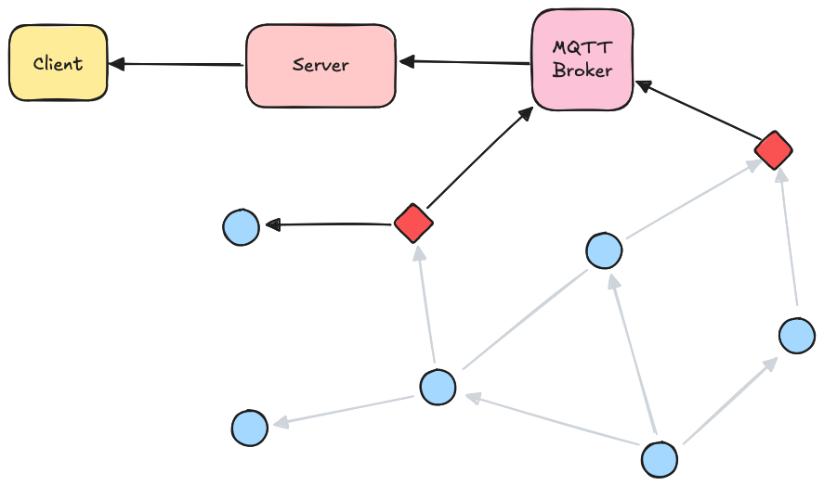
An example of the "flooding" method
Notes:
Which can send it to our client using the internet.
This method works great for a decentralised network because you don't have to look at the whole network holistically to work out the best routes
But although Meshtastic has done this in a slightly more optimised way that what I've explained, our message still had to be forwarded by a lot of radios to a lot of other radios which didn't even need the message

Slide 23
We could just do this!
Notes:
So it's not as efficient as following a predetermined route like this.

Slide 24
Our solution
Each node sends a message to its neighbors
Signal strength data can be extracted
Server can reconstruct a graph and determine the best routes
Notes:
Our solution is to use modified Meshtastic firmware on the radios and a server
to go through a process when the mesh starts up for the first time
in order to work out the best way for each radio to reach a gateway.
The rough outline of this process is for all the radios to send a message to all their neighbours from which we can extract some data about the signal strength between those two nodes

Slide 25

The solution
Notes:
The blue node sends a message and the highlighted orange nodes receive it
They now know what the signal strength between the blue node and themselves is

Slide 26
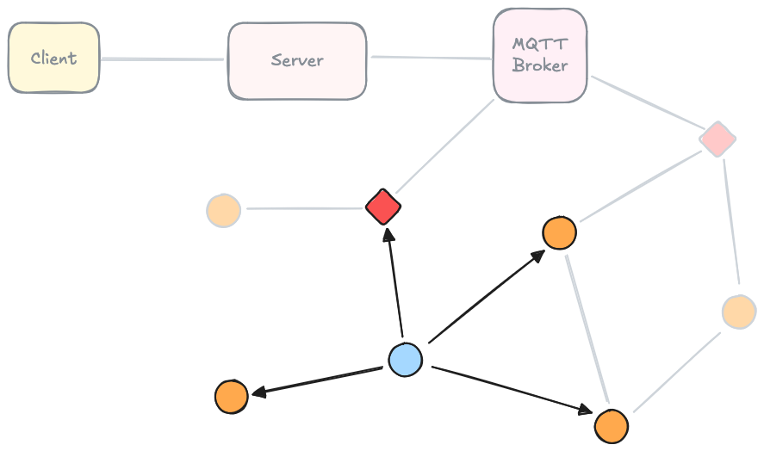
The solution
Notes:
The same thing happens here with a different node
When every node does this and sends the data they've gathered to the server, the server can reconstruct a graph of the network, determine – for each radio – which other radios they should try to hop to first in order to get to a gateway, and send that information to the mesh.

Slide 27

An example of using pathfinding
Notes:
Once we've done that, if we're this blue node again…

Slide 28
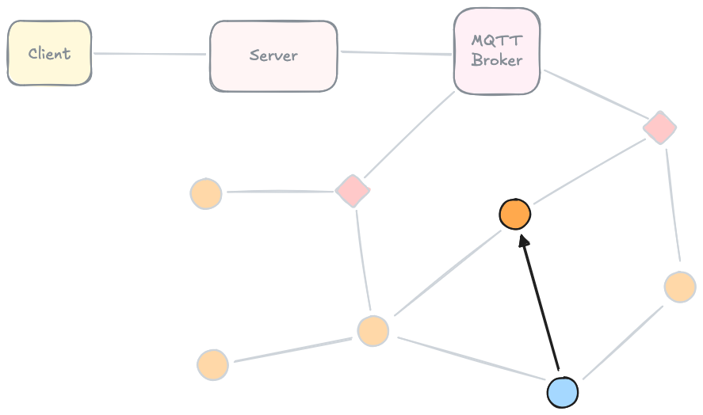
An example of using pathfinding
Notes:
Say, this is the best hop to make first…

Slide 29
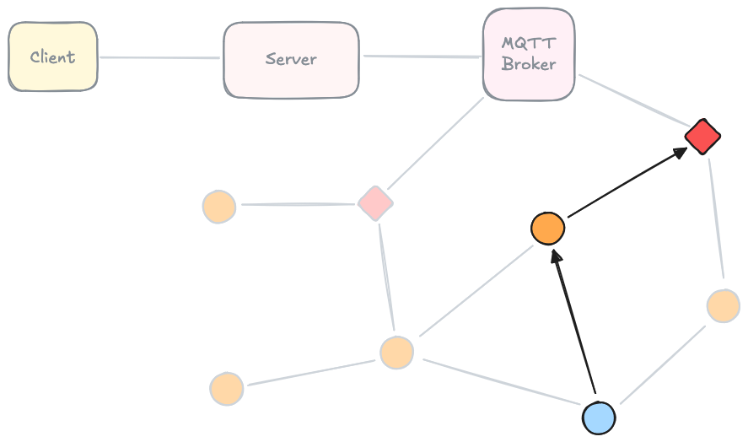
An example of using pathfinding
Notes:
Once our message is there, the next node sends it to the next best hop to get to a gateway
And in this case we can go straight there
But also if a message fails to make a step, every radio is able to fall back to another option

Slide 30
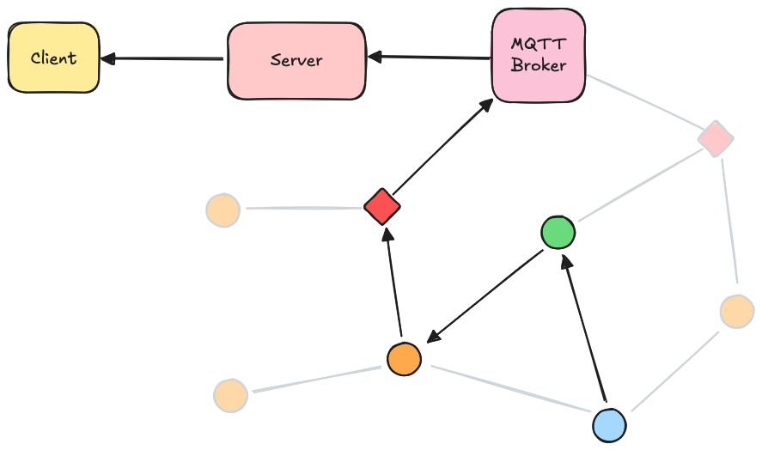
An example of using pathfinding
Notes:
So say for example:
if we make it from the blue radio to the green one
but we fail to reach the red gateway on the right,
we could go to the orange one to the left instead
and go from there using the same method
So using this method instead:
there's less traffic in network, which is important when the network becomes very large
we have redundancy for if parts of the mesh fail
and, even without internet the radios can remember where they should send messages in order to get to a gateway

Slide 31
A useful side-effect
Notes:
When the server runs its pathfinding algorithm, the data sent to the mesh can also be sent to the client to help visualise network topology, which is something that Meshtastic's apps are lacking completely currently
This is how this page that Migada mentioned earlier works
And although you can't see it in this image, it's also possible to colour code the lines to see which routes are best
And we can use that information to potentially deduce which parts of the network are weak

Slide 32
Live telemetry
Meshtastic has this too
We still have to be connected to a node with another device
That node would need to be able to reach every other node
We don't have control/flexibility over what metrics
Notes:
Meshtastic has this too
But we still have to be with a radio and connected to it with another device
AND, to get telemetry from the whole mesh, that radio would have to be able to reach every other radio
Even if that could be achieved we still don't much control or flexibility over what metrics we receive
So, part of our modification of the Meshtastic firmware involves sending our own telemetry from every single radio at some interval to be accessed on our own app.

Slide 33
Future plans
Gaining remote control of any radio in the network
Requesting telemetry from any single radio on an ad-hoc basis
Using the system in a decentralised manner if required
Storing telemetry in a database for long-term statistics
Notes:
I know Migada has mentioned these already, but I'll quickly give you reminder in case you have any questions.
Gaining remote control of any radio in the network for configuration purposes
Requesting telemetry from any single radio on an ad-hoc basis
This is useful if we're concerned about a particular node
and we need to see what's happening with it right in the moment
Using the system in a decentralised manner if required
Storing telemetry in a database for long-term statistics

Slide 34
Questions?
Notes:
I understand I've glazed over many technical details due to time restraint, so please ask questions about any specific things if you have any.

